Slide 1
Happy Houseplants:
Where Your New Friends Came From
Kyle Conway
Jong Kim
Emily McGrew
Jenny Shea

Slide 2

“This here is Reggie, he is a plant.
He says ‘Keep going,’
when I think I can't.”
SNL skit “Loco” ft. Bad Bunny, February 2021
Notes:
Jenny: This slide really encapsulates our inspiration and the pandemic plant ownership mood. This is a still from a Saturday Night Live Sketch about a woman who’s been spending a lot of time on her own, with her very encouraging new best friend, Reggie, a snake plant.
NEXT

Slide 3
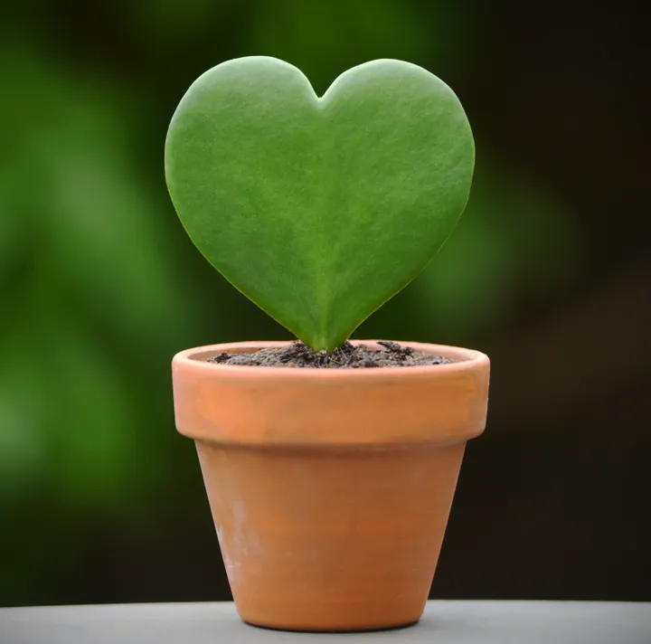
Emotional Connection to Plants
OVERSNAP VIA GETTY IMAGES
Notes:
Many people have always felt a connection to their house plants, which may be related to a phenomenon known as bioliophilia. This the idea that humans find comfort in nature due to our evolutionary history.
In a University of Seville study of 4,000 people, 3 in 4 respondents felt plants had a positive impact on mood.In another study, cited by Nursery Management and conducted by Stoneside Blinds and Shades, 43% of plant purchasers named their plants.
NEXT

Slide 4

Pandemic Houseplant B(l)oom
Deciding factors when choosing plants:
45% plant appearance
36% food plants
19% growing conditions
Notes:
In this study they found that during the first year of the pandemic, between March and December of 2020 houseplant owners spent an average of $125.50 on plants. The main factor that went into their purchasing decision was aesthetics and the least important factor identified was the growing requirements for a specific plant. Given the emotional and financial investment that plant people have in their plants we set out to design a dashboard that would help plant owners identify the region and growing conditions in which their plant natively thrives.
NEXT

Slide 5
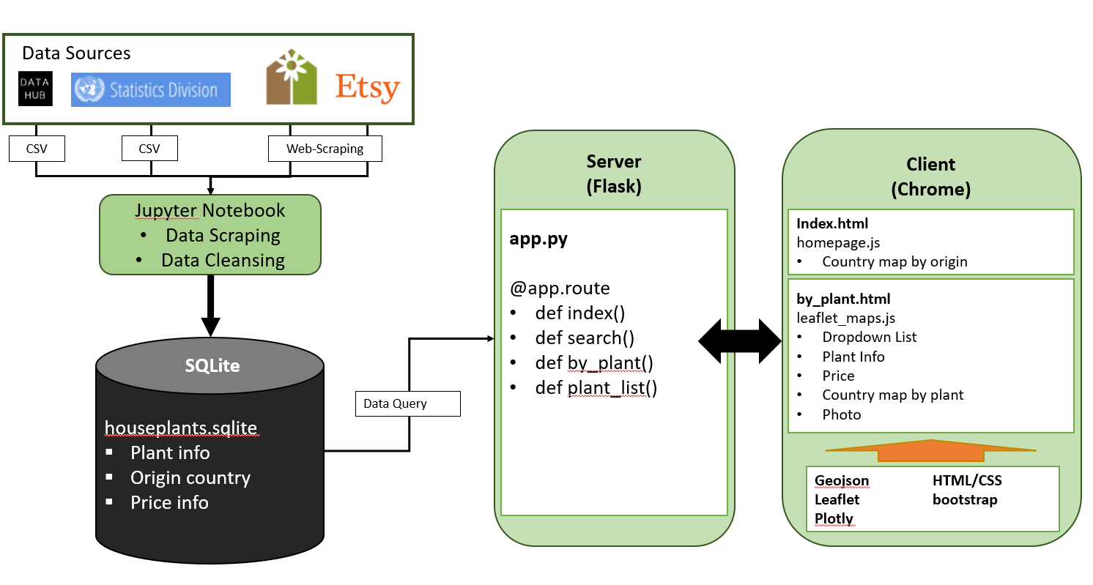
Data Architecture
Notes:
Jong

Slide 6
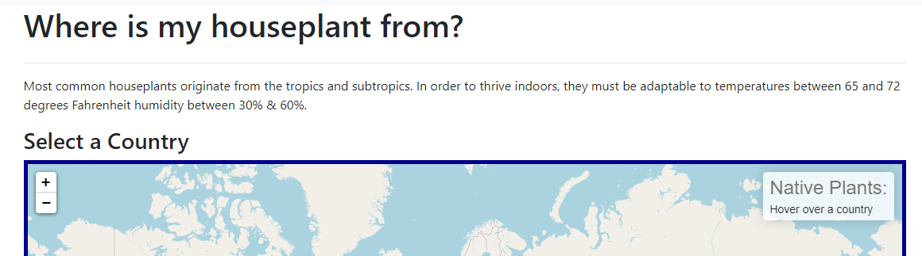
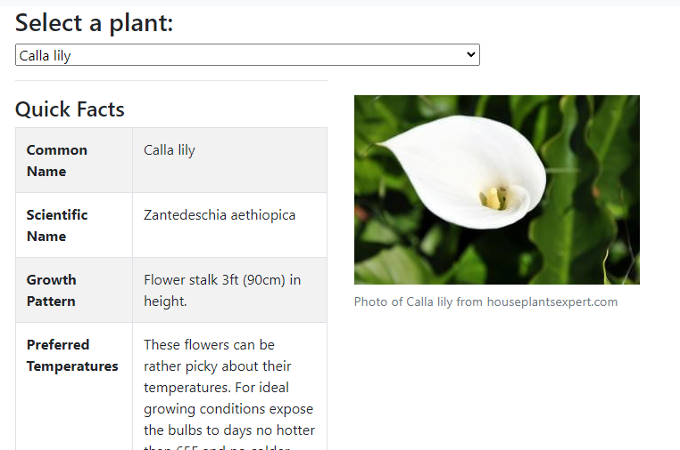
Let’s see the site!
Notes:
Emily

Slide 7
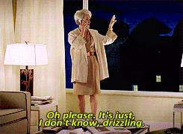
Next steps for this project/Conclusion
Incorporating weather reports for native countries
Expanding with more plants and more growing condition information,
Adding interactive button to collect data from users: have you killed this houseplant?
Notes:
Kyle
In discussing and recognizing the difficulties we had in manipulating our data we also wanted to discuss some things we would do give more time and opportunity:
Weather information: one component we weren’t able to manipulate was the weather data for each plant, either ideal sunlight and climate or by each planet’s individual country. We would ideally have gathered the weather and climate information for the native countries of the plants and manipulated our maps and other visualizations accordingly. Additionally we hoped to analyze this data to create a few charts or visuals to examine how many of the plants thrive in the tropics, etc.
Similarly, in analyzing the data and grouping the plants by country, we bumped into the realities of working with a limited data set with a set amount of plants. many were grouped to specific regions (South America and Africa, particularly). Moving forward a larger amount of plants would help expand the site’s possibilities.
Lastly, while drop downs and interactive map lists involve some user activity, one idea we didn’t have time for was an interactive feature for a button keyed to each individual plant regarding the site visitor’s personal experience (being a flask app and not deployed, we only discussed the possibility of this feature).

Slide 8
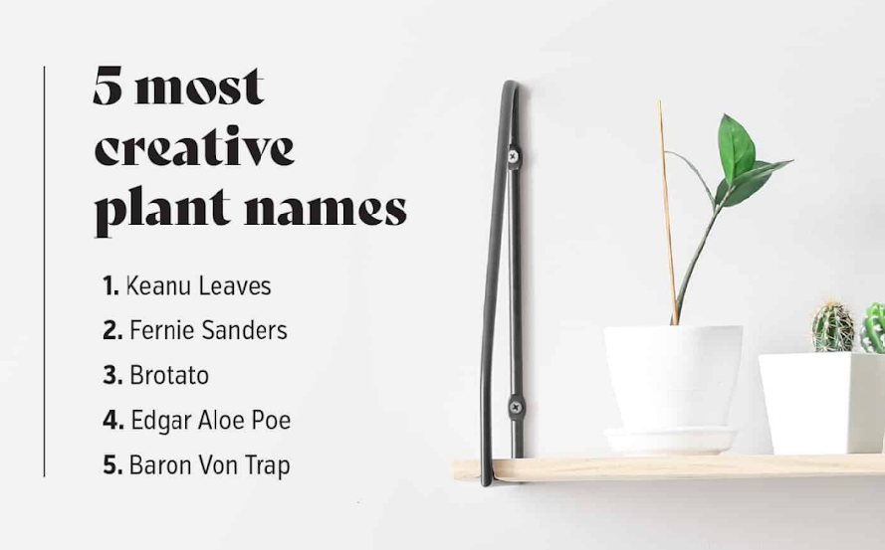
Questions?
(And more plant fun facts!)

Slide 9
References
For coding the website:
Houseplant list and information: https://www.houseplantsexpert.com/a-z-list-of-house-plants.html
Country geoJSON: https://datahub.io/core/geo-countries#javascript
Country to region matchup: https://unstats.un.org/unsd/methodology/m49/overview/
Etsy price information: https://etsy.com
Plant owner studies:
https://www.stoneside.com/resources/articles/plant-love
https://www.verywellmind.com/mental-health-benefits-of-houseplants-5097479
https://www.nurserymag.com/article/houseplant-mania-indoor-plants-trends-2020-june/

